Slide 1
Great Lakes Region
Pony Clubs
2020
LEG CONFORMATION
PICTURE CHALLENGE

Slide 2
Directions for this Challenge….
Take a picture of any horses LEG; front and/or hind legs
It can be a picture of your own horse or someone else’s horse. It is OK to scroll through your pictures on your phone and/or social media to insert the picture into this challenge.
No people should be in the picture
Best to have a picture even with the ground
Crop the picture to zoom in on the leg. If you are not sure how to crop the picture I can do that later.
Include Conformation Fault - it is OK if you do not know the conformation fault; the goal is to get as many leg conformation pictures as possible
Include the abbreviation for your Pony Club ie: GRPC, SSPC, RLPC, TBPC, etc
Insert 1 - 5 pictures
Sample on next slide

Slide 3
Conformation Fault
(if you are not sure of the fault that is OK)
OHPC

Slide 4
Conformation Fault
(if you are not sure of the fault that is OK)
GLR

Slide 5
Conformation Fault
(if you are not sure of the fault that is OK)
GLR

Slide 6
Conformation Fault
(if you are not sure of the fault that is OK)
CLUB

Slide 7
Conformation Fault
(if you are not sure of the fault that is OK)
GLR

Slide 8
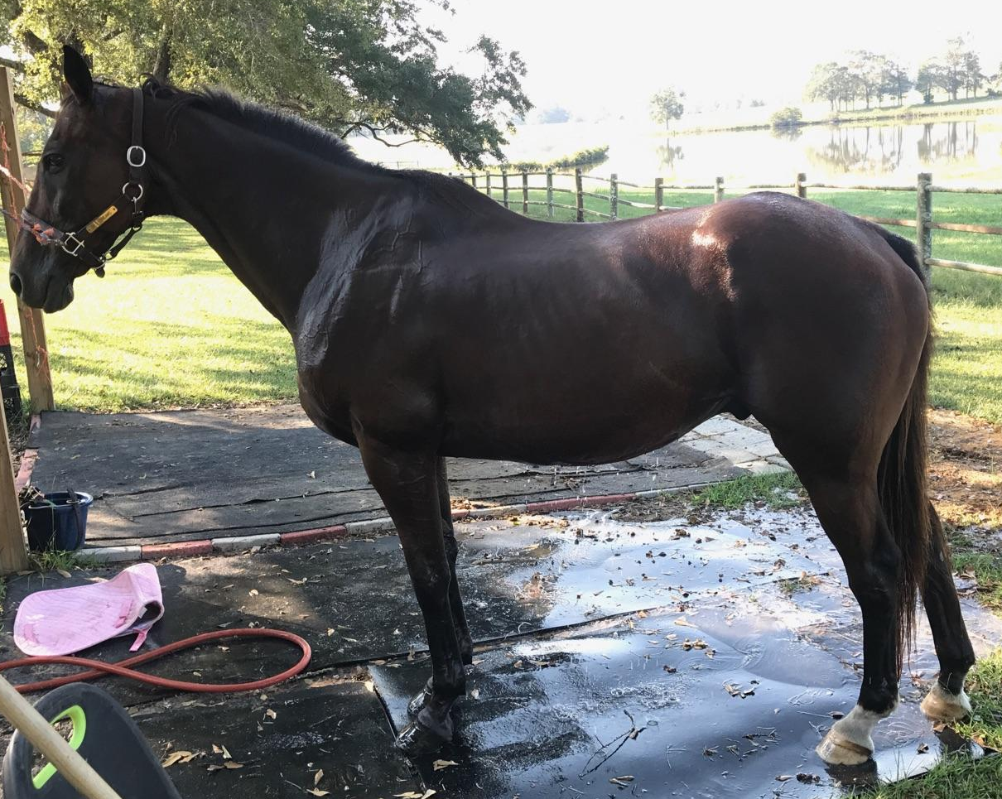
Conformation Fault
OHPC

Slide 9
Conformation Fault
(if you are not sure of the fault that is OK)
CLUB

Slide 10
Conformation Fault
(if you are not sure of the fault that is OK)
CLUB

Slide 11
Conformation Fault
(if you are not sure of the fault that is OK)
CLUB

Slide 12
Conformation Fault
(if you are not sure of the fault that is OK)
CLUB

Slide 13
Conformation Fault
(if you are not sure of the fault that is OK)
CLUB

Slide 14
Conformation Fault
(if you are not sure of the fault that is OK)
CLUB

Slide 15
Conformation Fault
(if you are not sure of the fault that is OK)
CLUB

Slide 16
Conformation Fault
(if you are not sure of the fault that is OK)
CLUB

Slide 17
Conformation Fault
(if you are not sure of the fault that is OK)
CLUB

Slide 18
Conformation Fault
(if you are not sure of the fault that is OK)
CLUB

Slide 19
Conformation Fault
(if you are not sure of the fault that is OK)
CLUB

Slide 20
Conformation Fault
(if you are not sure of the fault that is OK)
CLUB

Slide 21
Conformation Fault
(if you are not sure of the fault that is OK)
CLUB

Slide 22
Conformation Fault
(if you are not sure of the fault that is OK)
CLUB

Slide 23
Conformation Fault
(if you are not sure of the fault that is OK)
CLUB

Slide 24
Conformation Fault
(if you are not sure of the fault that is OK)
CLUB

Slide 25
Conformation Fault
(if you are not sure of the fault that is OK)
CLUB

Slide 26
Conformation Fault
(if you are not sure of the fault that is OK)
CLUB

Slide 27
Conformation Fault
(if you are not sure of the fault that is OK)
CLUB

Slide 28
Conformation Fault
(if you are not sure of the fault that is OK)
CLUB

Slide 29
Conformation Fault
(if you are not sure of the fault that is OK)
CLUB

Slide 30
Conformation Fault
(if you are not sure of the fault that is OK)
CLUB

Slide 31
Conformation Fault
(if you are not sure of the fault that is OK)
CLUB

Slide 32
Conformation Fault
(if you are not sure of the fault that is OK)
CLUB

Slide 33
Conformation Fault
(if you are not sure of the fault that is OK)
CLUB

Slide 34
Conformation Fault
(if you are not sure of the fault that is OK)
CLUB

Slide 35
Conformation Fault
(if you are not sure of the fault that is OK)
CLUB

Slide 36
Conformation Fault
(if you are not sure of the fault that is OK)
CLUB

Slide 37
Conformation Fault
(if you are not sure of the fault that is OK)
CLUB

Slide 38
Conformation Fault
(if you are not sure of the fault that is OK)
CLUB

Slide 39
Conformation Fault
(if you are not sure of the fault that is OK)
CLUB

Slide 40
Conformation Fault
(if you are not sure of the fault that is OK)
CLUB

Slide 41
Conformation Fault
(if you are not sure of the fault that is OK)
CLUB

Slide 42
Conformation Fault
(if you are not sure of the fault that is OK)
CLUB

Slide 43
Conformation Fault
(if you are not sure of the fault that is OK)
CLUB

Slide 44
Conformation Fault
(if you are not sure of the fault that is OK)
CLUB

Slide 45
Conformation Fault
(if you are not sure of the fault that is OK)
CLUB

Slide 46
Conformation Fault
(if you are not sure of the fault that is OK)
CLUB

Slide 47
Conformation Fault
(if you are not sure of the fault that is OK)
CLUB

Slide 48
Conformation Fault
(if you are not sure of the fault that is OK)
CLUB

Slide 49
Conformation Fault
(if you are not sure of the fault that is OK)
CLUB

Slide 50
Conformation Fault
(if you are not sure of the fault that is OK)
CLUB

